Slide 1
Overview of the Water4All candidate EU Partnership
21 Janvier 2021

Slide 2
Candidate European Partnership Water Security for the Planet (Water4All)
Form: Co-funded partnership
Partners:
National/regional research funders and policy makers as core members
in association with other research and economic actors
Lead DG(s): R&I, ENV
Predecessor: Building on the work of the Water JPI, the EIP Water and the Water Europe Technology Platform
Launch: Horizon Europe WP 2021/22

Slide 3
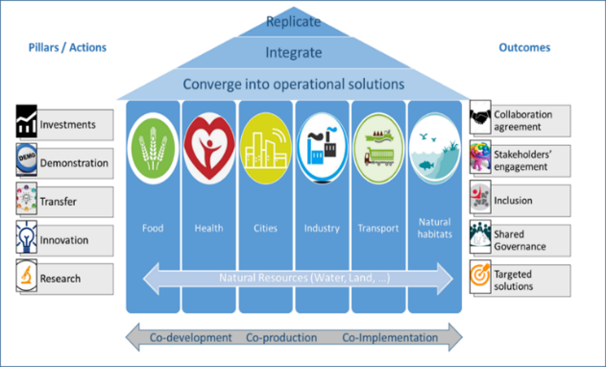
Aim of the Partnership
Concentrating research and innovation and the funding landscape of water in Europe and beyond.
Enabling water security for all on the long term by boosting systemic transformations and changes across the entire water research and innovation pipeline, fostering the matchmaking between problem owners and solution providers.
cross-sectoral approach, encompassing policy, environmental, economic, technological and societal considerations.
continuum from knowledge development to the transfer and practice to the actors of policy, operators and society.

Slide 4
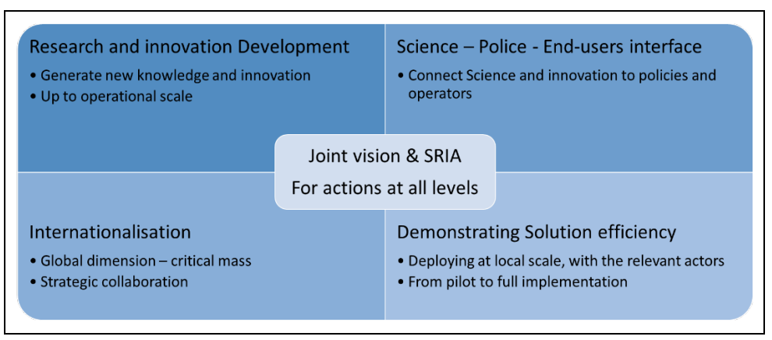
Main activities
B.
C.
A.
E.
D.
A broad range of activities along the R&I chain of value:
Alignment of national and regional programmes; research synergies among networks;
Joint calls, transfer calls, new formats to account for knowledge and innovation transfer;
Joint activities such as knowledge hubs, engaging with demonstration sites or living labs, roadshows, science-policy interface documents and events
Contribution to UN monitoring, decrease of barriers in international cooperation.

Slide 5
Participation opportunities
Alignment of research & innovation agenda
Participation in open calls launched by the Partnership
Collaboration in activities of common interest
Use of research infrastructure / data collection
Connection with ongoing / new demonstration sites
Knowledge transfer, capacity building
Modalities to be defined
Pillar A
Pillar B
Pillar E

Slide 6
Expected schedule
Call publication ~ April?
Submission deadline 3 months later
Launch early 2022

Slide 7
Strategic Research and Innovation Agenda
V0
V0.5
V1.0

Slide 8
Questions?

Slide 9
Contacts for Water4All
Commission services: Panagiotis Balabanis
Partners: Agence Nationale de la Recherche (ANR) – Olivier Bouc; Waterjpisecretariat@agencerecherche.fr
Detailed draft proposal of Water4All available at: https://ec.europa.eu/info/files/european-partnership-water4all-water-security-planet_en

